Slide 1

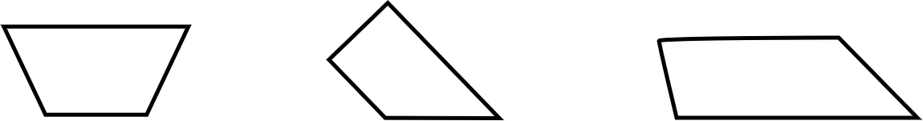
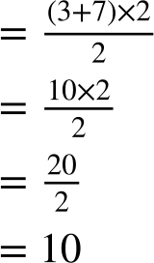
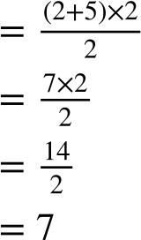
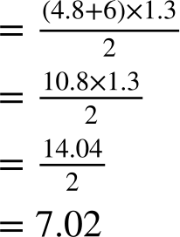
Calculating missing side lengths from the area of a trapezium
Task A: Calculating the area of a trapezium
1) Calculate the area of each trapezium.
a) b) c)
7 cm
2 cm
4.8 cm
5 cm
2.9 cm
4 cm
2 cm
4 cm
2 cm
1.3 cm
2 cm
3 cm
3 cm
6 cm
Area
Area
Area
units²
units²
units²

Slide 2
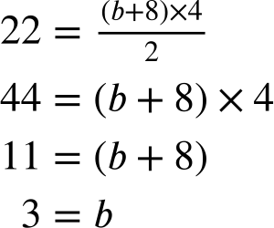
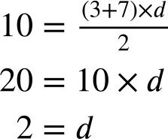
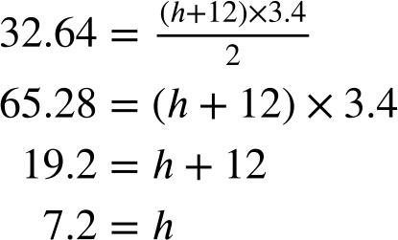
Calculating missing side lengths from the area of a trapezium
Task B: Finding a missing side length using the area
1) Calculate the length of the marked side and then, if possible, calculate the perimeter.
a) b) c)
Area = 22 m² Area = 10 cm² Area = 32.64 cm²
8 m
7 cm
4 m
3.4 cm
4.9 cm
5 m
3 cm
4 cm
12 cm
The length is 3 m.
The perimeter is 8 + 5 + 5 + ‘3’ = 21 m
The length is 2 cm.
The perimeter is 7 + 4 + 3 + ‘2’ = 16 cm
The length is 7.2 cm.
The perimeter cannot be found as one side length is still unknown.
Mathematics in Education and Industry.

